Slide 1
What is a Graph?
A graph G = (V,E) is composed of:
V: set of vertices
E: set of edges connecting the vertices in V
An edge e = (u,v) is a pair of vertices
Example:
a
b
V= {a,b,c,d,e}
E= {(a,b),(a,c),(a,d),
(b,e),(c,d),(c,e),
(d,e)}
c
d
e

Slide 2
Applications
electronic circuits
networks (roads, flights, communications)
CS16
JFK
LAX
LAX
STL
HNL
DFW
FTL

Slide 3


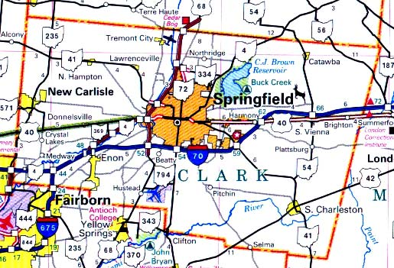

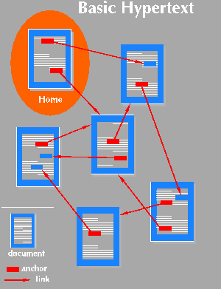
Applications
Schedules
Computer networks
Maps
Hypertext
Circuits

Slide 4
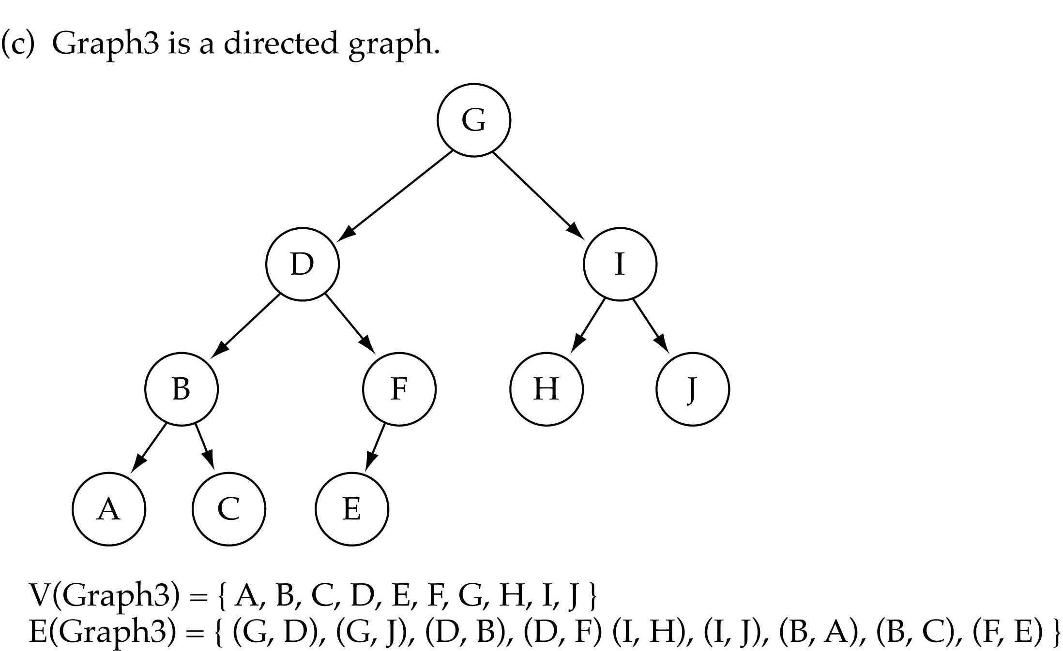
Trees vs graphs
Trees are special cases of graphs!!
I

Slide 5
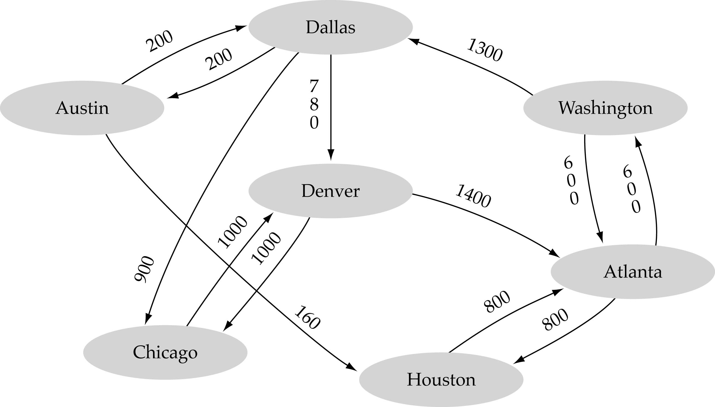
Graph terminology (cont.)
Weighted graph: a graph in which each edge carries a value

Slide 6
Terminology:
Adjacent and Incident
If (v0, v1) is an edge in an undirected graph,
  v0 and v1 are adjacent
  The edge (v0, v1) is incident on vertices v0 and v1
If <v0, v1> is an edge in a directed graph
  v0 is adjacent to v1, and v1 is adjacent from v0
  The edge <v0, v1> is incident on v0 and v1

Slide 7
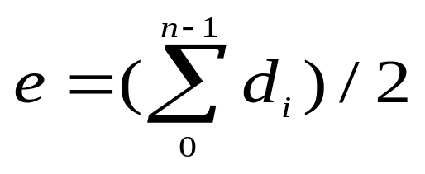

Terminology:
Degree of a Vertex
The degree of a vertex is the number of edges incident to that vertex
For directed graph,
  the in-degree of a vertex v is the number of edges
  that have v as the head
  the out-degree of a vertex v is the number of edges
  that have v as the tail
  if d_{i} is the degree of a vertex i in a graph G with n vertices and e edges, the number of edges is
Why? Since adjacent vertices each
count the adjoining edge, it will be
counted twice

Slide 8
Examples
G1
G2
0
3
2
0
1
2
3
3
3
1
2
3
3
4
5
6
3
1
1
1
1
3
0
in:1, out: 1
directed graph
in-degree
out-degree
1
in: 1, out: 2
2
in: 1, out: 0
G3

Slide 9
Terminology:
Path
path: sequence of vertices v₁,v₂,. . .v_{k} such that consecutive vertices v_{i} and v_{i+1} are adjacent.
3
2
3
3
3
a
b
a
b
c
c
d
e
d
e
a b e d c
b e d c

Slide 10
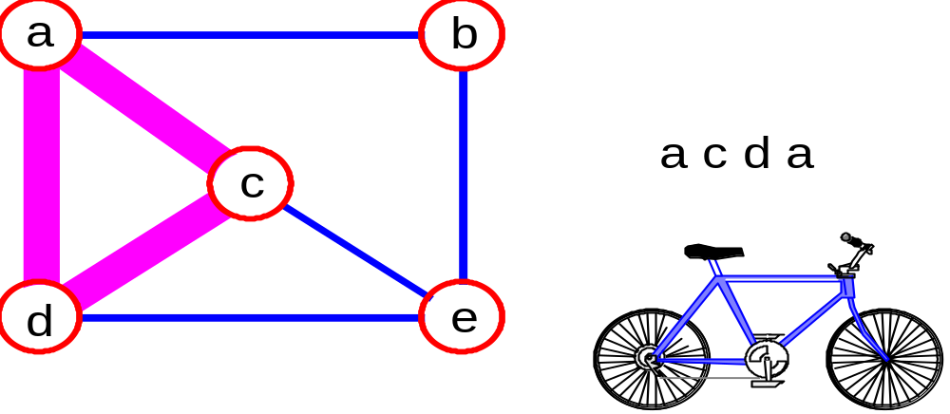
More Terminology
simple path: no repeated vertices
cycle: simple path, except that the last vertex is the same as the first vertex
a
b
b e c
c
d
e

Slide 11
Even More Terminology
connected graph: any two vertices are connected by some path
connected
not connected
subgraph: subset of vertices and edges forming a graph

Slide 12
Subgraphs Examples
0
0
0
1
2
0
1
2
1
2
3
1
2
3
G1
(i) (ii) (iii) (iv)
(a) Some of the subgraph of G₁
3
0
0
0
0
0
1
1
1
1
2
2
2
(i) (ii) (iii) (iv)
(b) Some of the subgraph of G₃
G3

Slide 13
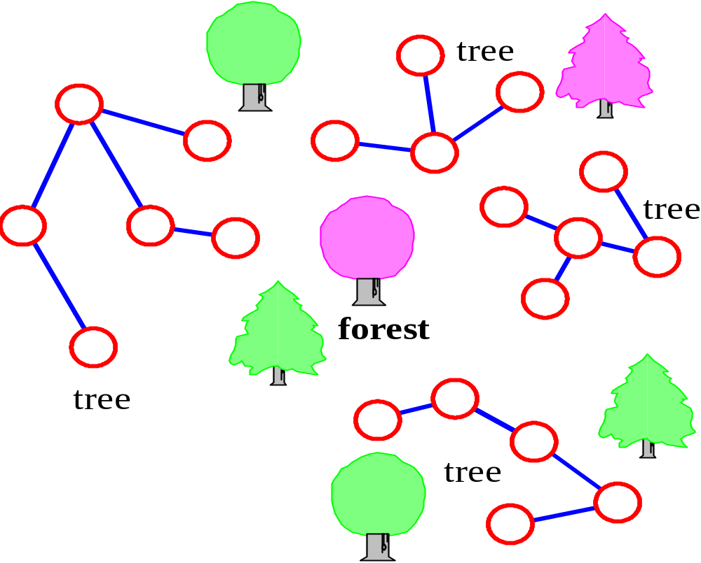
More…
tree - connected graph without cycles
forest - collection of trees

Slide 14
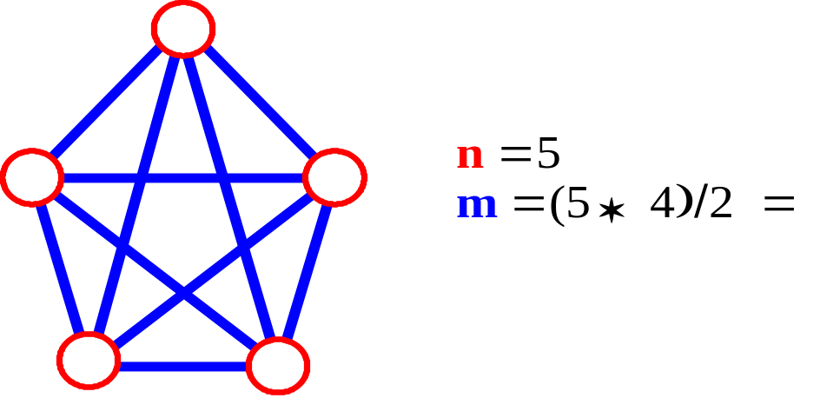
Connectivity
Let n = #vertices, and m = #edges
A complete graph: one in which all pairs of vertices are adjacent
How many total edges in a complete graph?
  Each of the n vertices is incident to n-1 edges, however, we would have counted each edge twice! Therefore, intuitively, m = n(n -1)/2.
Therefore, if a graph is not complete, m < n(n -1)/2

Slide 15
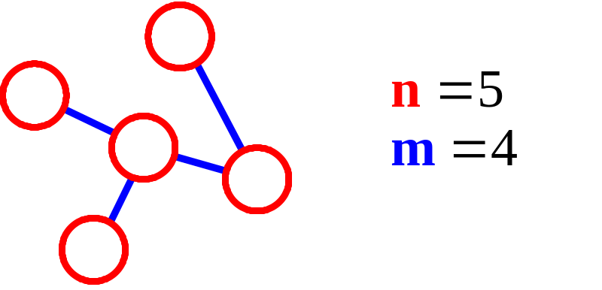
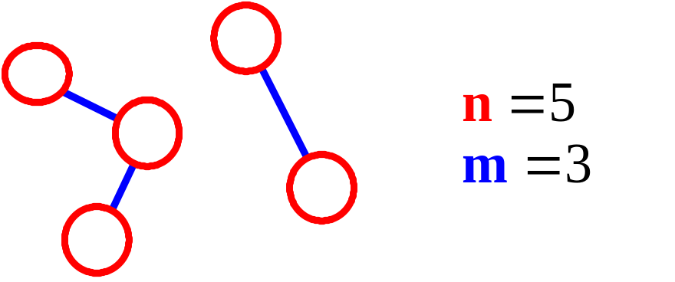
More Connectivity
n = #vertices
m = #edges
For a tree m = n - 1
If m < n - 1, G is not connected

Slide 16
Oriented (Directed) Graph
A graph where edges are directed

Slide 17
Directed vs. Undirected Graph
An undirected graph is one in which the pair of vertices in a edge is unordered, (v0, v1) = (v1,v0)
A directed graph is one in which each edge is a directed pair of vertices, <v0, v1> != <v1,v0>
tail
head

Slide 18
Graph Representations
Adjacency Matrix
Adjacency Lists

Slide 19
Adjacency Matrix
Let G=(V,E) be a graph with n vertices.
The adjacency matrix of G is a two-dimensional
n by n array, say adj_mat
If the edge (vi, vj) is in E(G), adj_mat[i][j]=1
If there is no such edge in E(G), adj_mat[i][j]=0
The adjacency matrix for an undirected graph is symmetric; the adjacency matrix for a digraph
need not be symmetric

Slide 20
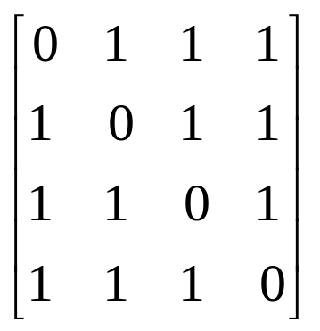
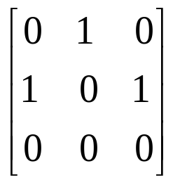
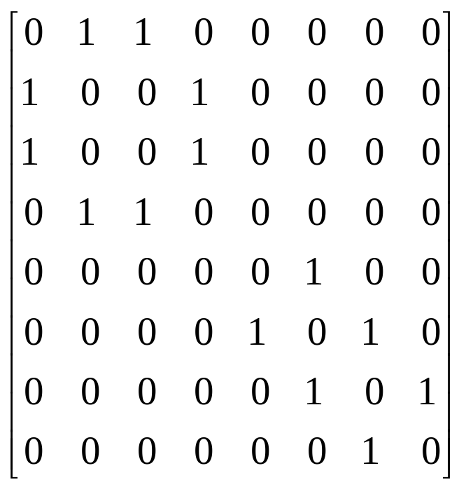
Examples for Adjacency Matrix
0
0
4
0
2
1
5
1
2
3
6
3
1
7
2
G2
G1
G4

Slide 21
Adjacency Lists (data structures)
Each row in adjacency matrix is represented as an adjacency list.
Const int MAX_VERTICES= 50
typedef struct node *node_pointer;
typedef struct node {
int vertex;
node *link;
}*node_pointer;
;
node_pointer graph[MAX_VERTICES];
int n=0; /* vertices currently in use */

Slide 22
0
0
4
2
1
5
1
2
3
6
3
7
0
1
2
3
1
2
3
0
1
2
3
4
5
6
7
1
2
0
2
3
0
3
0
1
3
0
3
0
1
2
1
2
G1
0
5
4
6
0
1
2
1
5
7
0
2
1
6
G3
G4
2
An undirected graph with n vertices and e edges ==> n head nodes and 2e list nodes

Slide 23
Array-based implementation
Use a 1D array to represent the vertices
Use a 2D array (i.e., adjacency matrix) to represent the edges

Slide 24
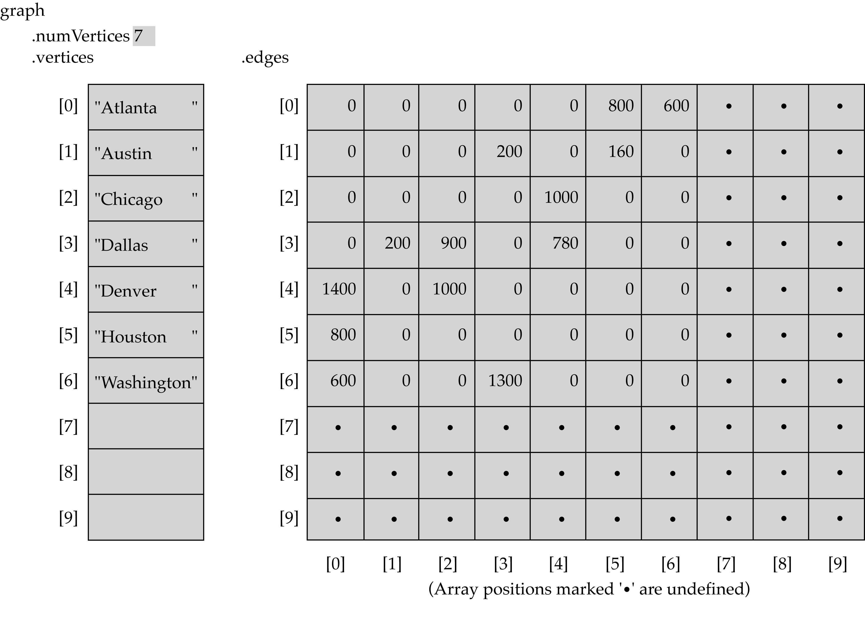
Array-based implementation (cont’d)

Slide 25
Array-Based Implementation (cont.)
Memory required
  O(V+V²)=O(V²)
Preferred when
  The graph is dense: E = O(V²)
Advantage
  Can quickly determine
  if there is an edge between two vertices
Disadvantage
  No quick way to determine the vertices adjacent
  from another vertex
x
?

Slide 26
Linked-list-based implementation
Use a 1D array to represent the vertices
Use a list for each vertex v which contains the vertices which are adjacent from v (adjacency list)

Slide 27
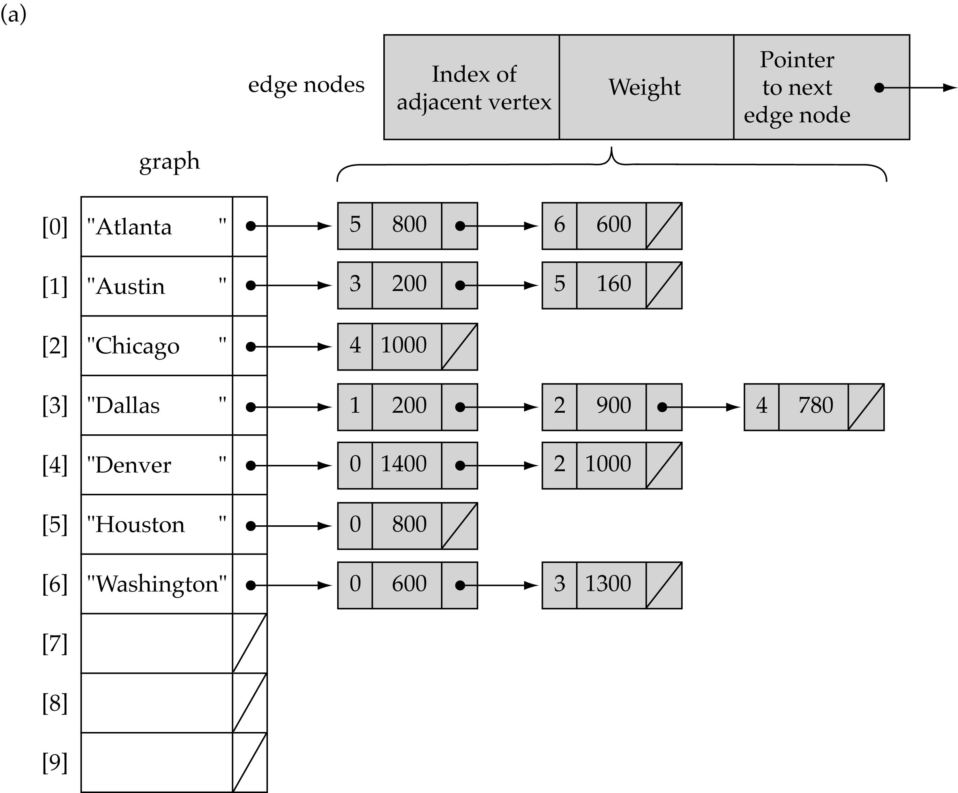
Linked-list-based implementation (cont’d)

Slide 28
Graph Traversal
Problem: Search for a certain node or traverse all nodes in the graph
Depth First Search
Breadth First Search
  Visualizations
  https://www.cs.usfca.edu/~galles/visualization/Algorithms.html

Slide 29
Graph Traversals
Depth-First Traversals.
Breadth-First Traversal.

Slide 30
Depth-First-Search (DFS)
Main idea:
  Travel as far as you can down a path
  Back up as little as possible when you reach a "dead end" (i.e., next vertex has been "marked" or there is no next vertex)
DFS uses a stack !

Slide 31
Depth-First Search
DFS follows the following rules:
  Select an unvisited node x, visit it, and treat as the current node
  Find an unvisited neighbor of the current node, visit it, and make it the new current node;
  If the current node has no unvisited neighbors, backtrack to the its parent, and make that parent the new current node;
  Repeat steps 3 and 4 until no more nodes can be visited.
  If there are still unvisited nodes, repeat from step 1.

Slide 32
Depth-First Traversal Algorithm
In this method, After visiting a vertex v, which is adjacent to w1, w2, w3, ...; Next we visit one of v's adjacent vertices, w1 say. Next, we visit all vertices adjacent to w1 before coming back to w2, etc.
Must keep track of vertices already visited to avoid cycles.
The method can be implemented using recursion or iteration.
The iterative preorder depth-first algorithm is:
1 push the starting vertex onto the stack
2 while(stack is not empty){
3 pop a vertex off the stack, call it v
4 if v is not already visited, visit it
push vertices adjacent to v, not visited, onto the stack
}
Note: Adjacent vertices can be pushed in any order; but to obtain a unique
traversal, we will push them in reverse alphabetical order.

Slide 33
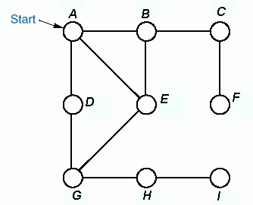


Example
Demonstrates depth-first traversal using an explicit stack.
Order of
Traversal
A B C F E G D H I
Stack

Slide 34
Recursive preorder Depth-First Traversal Implementation
dfsPreorder(v){
visit v;
for(each neighbour w of v)
if(w has not been visited)
dfsPreorder(w);
}
The following is the code for the recursive preorderDepthFirstTraversal method of the AbstractGraph class:
public void preorderDepthFirstTraversal(Visitor visitor, Vertex start)
{
boolean visited[] = new boolean[numberOfVertices];
for(int v = 0; v < numberOfVertices; v++)
visited[v] = false;
preorderDepthFirstTraversal(visitor, start, visited);
}

Slide 35
Recursive preorder Depth-First Traversal Implementation (cont’d)
private void preorderDepthFirstTraversal(Visitor visitor,
Vertex v, boolean[] visited)
{
if(visitor.isDone())
return;
visitor.visit(v);
visited[getIndex(v)] = true;
Iterator p = v.getSuccessors();
while(p.hasNext()) {
Vertex to = (Vertex) p.next();
if(! visited[getIndex(to)])
preorderDepthFirstTraversal(visitor, to, visited);
}
}

Slide 36
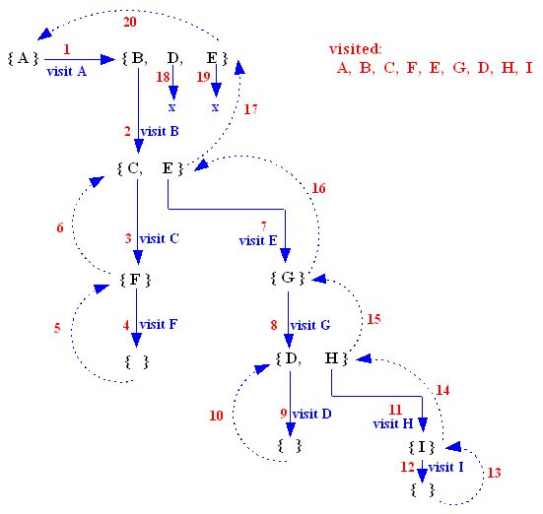
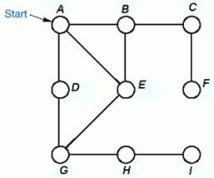
Recursive preorder Depth-First Traversal Implementation (cont’d)
At each stage, a set of unvisited adjacent vertices of the current vertex is generated.

Slide 37
Recursive postorder Depth-First Traversal Implementation
dfsPostorder(v){
mark v;
for(each neighbour w of v)
if(w is not marked)
dfsPostorder(w);
visit v;
}
The following is the code for the recursive postorderDepthFirstTraversal method of the AbstractGraph class:
public void postorderDepthFirstTraversal(Visitor visitor,
Vertex start)
{
boolean visited[] = new boolean[numberOfVertices];
for(int v = 0; v < numberOfVertices; v++)
visited[v] = false;
postorderDepthFirstTraversal(visitor, start, visited);
}

Slide 38
Recursive postorder Depth-First Traversal Implementation (cont’d)
private void postorderDepthFirstTraversal(
Visitor visitor, Vertex v, boolean[] visited)
{
if(visitor.isDone())
return;
// mark v
visited[getIndex(v)] = true;
Iterator p = v.getSuccessors();
while(p.hasNext()){
Vertex to = (Vertex) p.next();
if(! visited[getIndex(to)])
postorderDepthFirstTraversal(visitor, to, visited);
}
// visit v
visitor.visit(v);
}

Slide 39
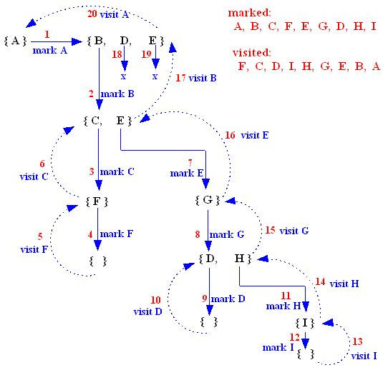
Recursive postorder Depth-First Traversal Implementation (cont’d)
At each stage, a set of unmarked adjacent vertices of the current vertex is generated.

Slide 40
Breadth-First-Searching (BFS)
Main idea:
  Look at all possible paths at the same depth before you go at a deeper level
  Back up as far as possible when you reach a "dead end" (i.e., next vertex has been "marked" or there is no next vertex)
BFS uses a queue !

Slide 41
Breadth-First Search
BFS follows the following rules:
  Select an unvisited node x, visit it, have it be the root in a BFS tree being formed. Its level is called the current level.
  From each node z in the current level, in the order in which the level nodes were visited, visit all the unvisited neighbors of z. The newly visited nodes from this level form a new level that becomes the next current level.
  Repeat step 2 until no more nodes can be visited.
  If there are still unvisited nodes, repeat from Step 1.

Slide 42
Breadth-First Traversal Algorithm
In this method, After visiting a vertex v, we must visit all its adjacent vertices w1, w2, w3, ..., before going down next level to visit vertices adjacent to w1 etc.
The method can be implemented using a queue.
A boolean array is used to ensure that a vertex is enqueued only once.
1 enqueue the starting vertex
2 while(queue is not empty){
3 dequeue a vertex v from the queue;
4 visit v.
enqueue vertices adjacent to v that were never enqueued;
}
Note: Adjacent vertices can be enqueued in any order; but to obtain a unique
traversal, we will enqueue them in alphabetical order.

Slide 43
Example
Demonstrating breadth-first traversal using a queue.
Queue front
Order of
Traversal
A B D E C G F H I
Queue rear

Slide 44
Breadth-First Traversal Implementation
public void breadthFirstTraversal(Visitor visitor, Vertex start){
boolean enqueued[] = new boolean[numberOfVertices];
for(int i = 0; i < numberOfVertices; i++) enqueued[i] = false;
Queue queue = new QueueAsLinkedList();
enqueued[getIndex(start)] = true;
queue.enqueue(start);
while(!queue.isEmpty() && !visitor.isDone()) {
Vertex v = (Vertex) queue.dequeue();
visitor.visit(v);
Iterator it = v.getSuccessors();
while(it.hasNext()) {
Vertex to = (Vertex) it.next();
int index = getIndex(to);
if(!enqueued[index]) {
enqueued[index] = true;
queue.enqueue(to);
}
}
}
}

Slide 45
